Slide 1
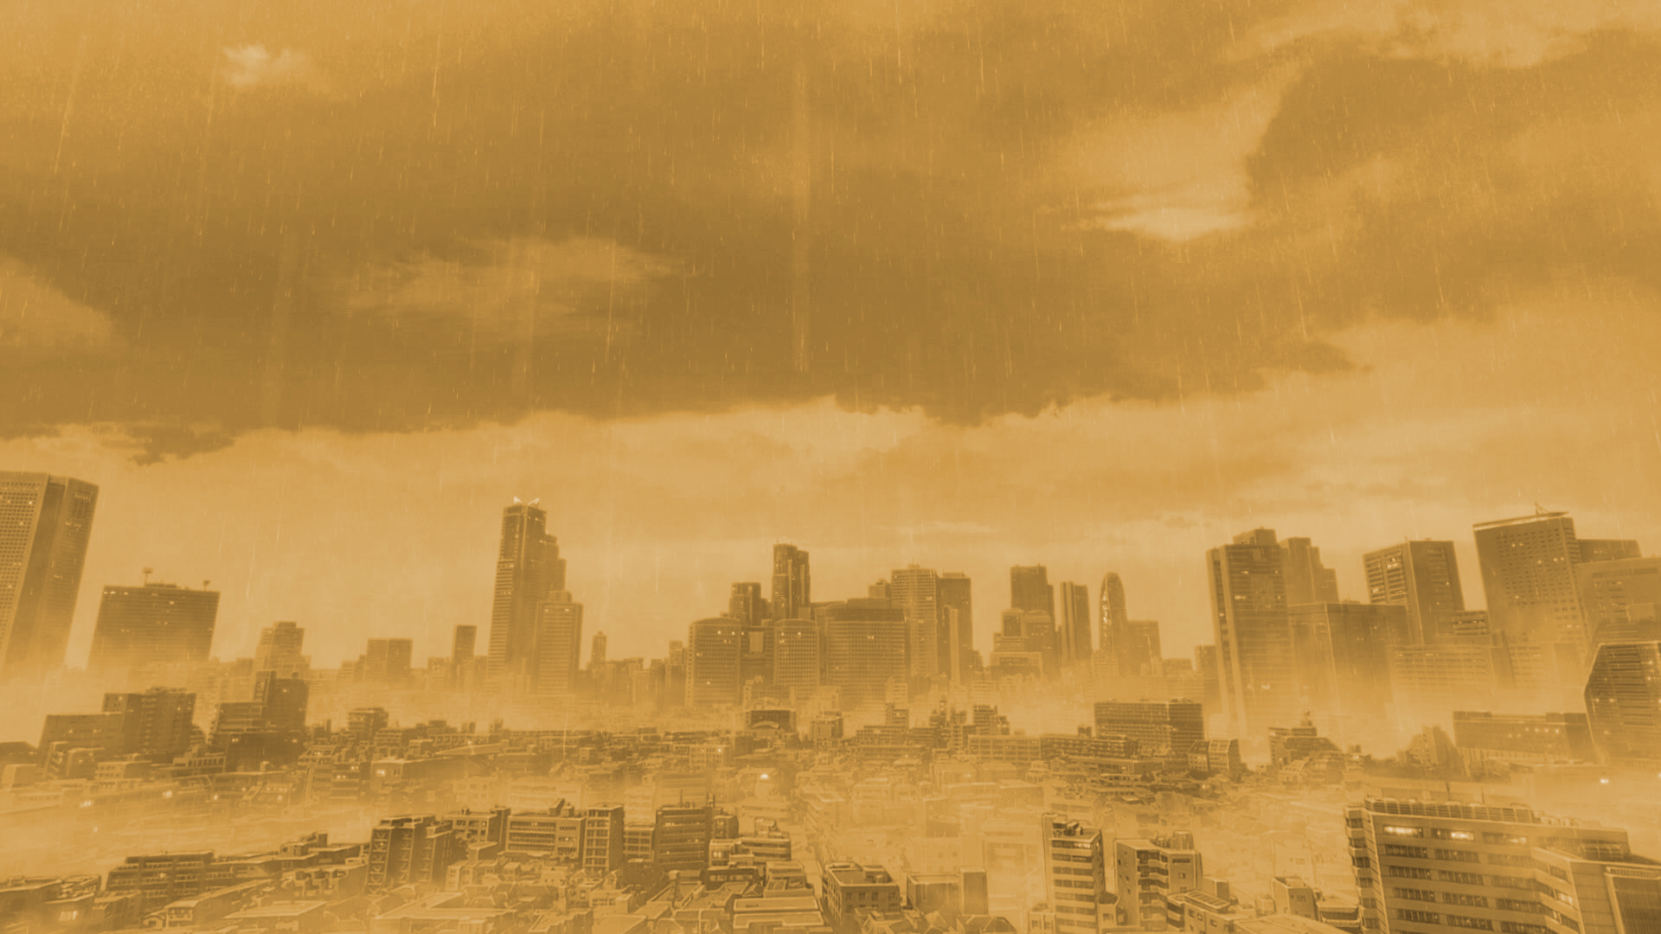
Tokyo
Heavy rains and water management
Arthur Guillot – Le Goff
Spatial planning for flood protection - University of Ljubljana Autumn semester of 2021

Slide 2
Table of contents
The Japan nature paradox
Tokyo the boiling and drowning city
Water management in the biggest megacity

Slide 3
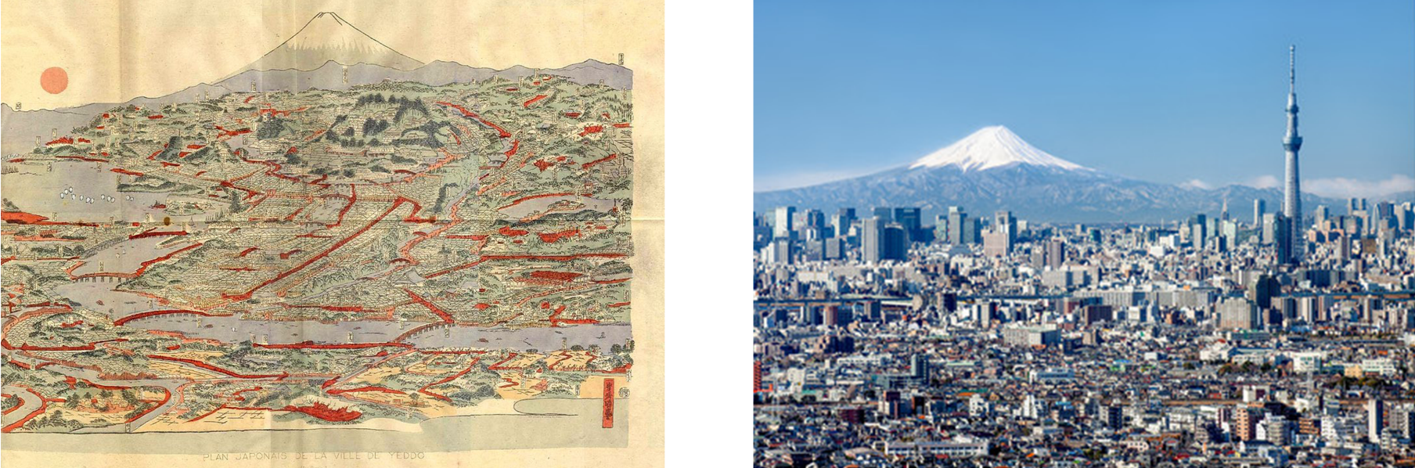
The Japan nature paradox
Edo city stamp and nowadays Tokyo skyline (Wikipedia, Jan Christopher Becke)

Slide 4
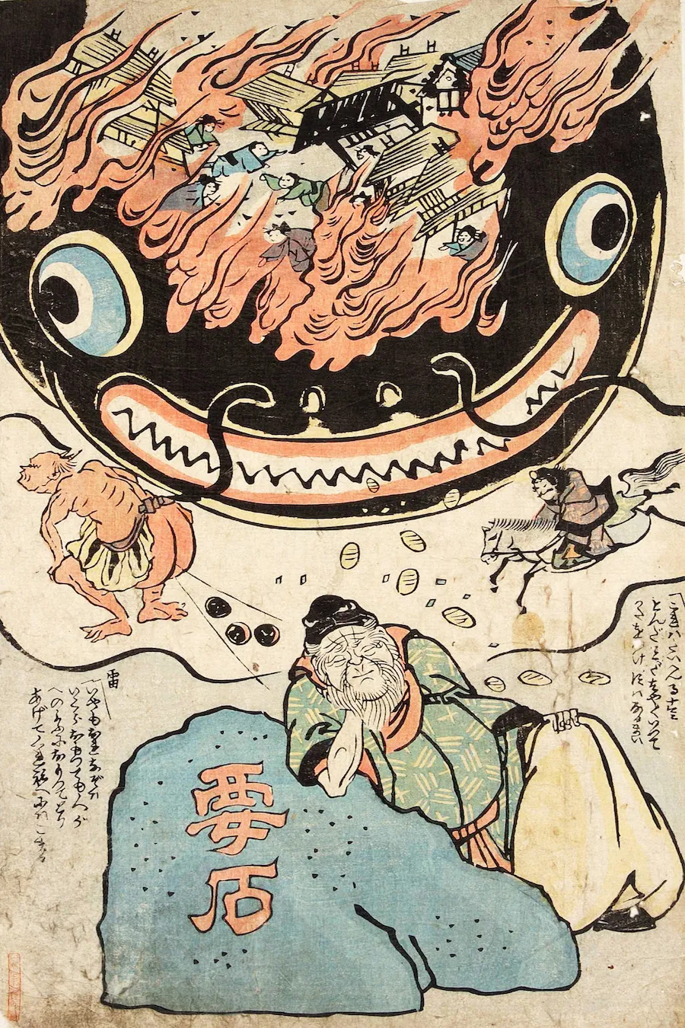
The Japan nature paradox
Kami, the source of disasters
Wealth and the burden of the monsoon
Otarcism and the acceptance of foreign technology
Namazu to Kaname-ishi or 'Namazu and the Foundation Stone', (1855), artist unknown. Source: Tokyo Metropolitan Library

Slide 5
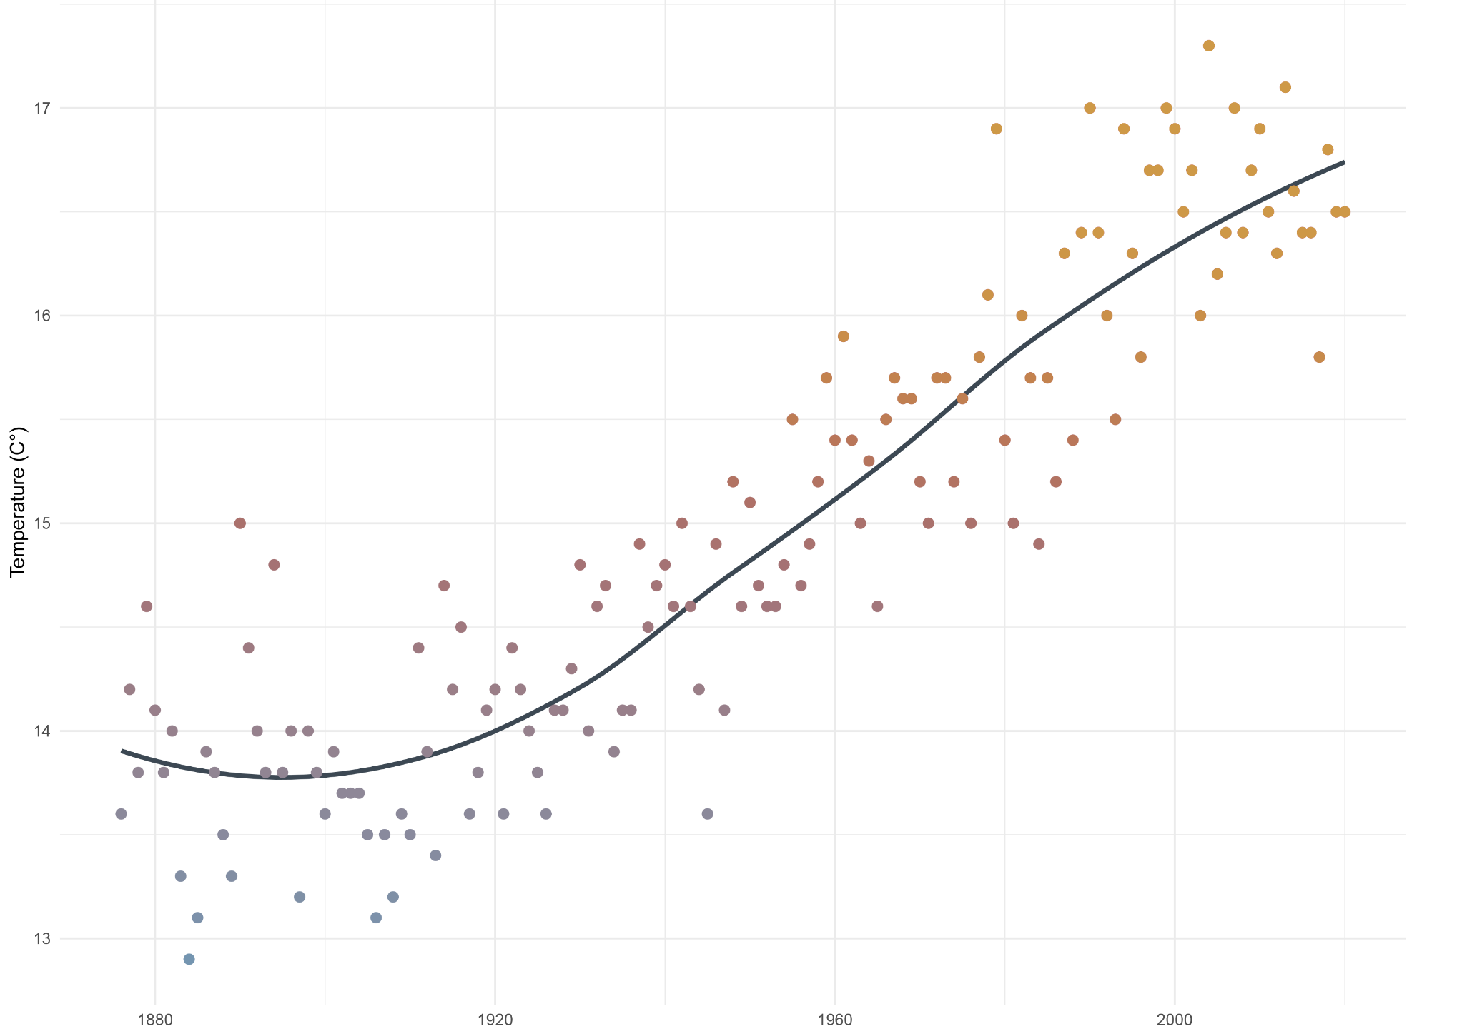
The boiling and drowning city
Average annual temperature measured at the WMO weather station in Tokyo

Slide 6
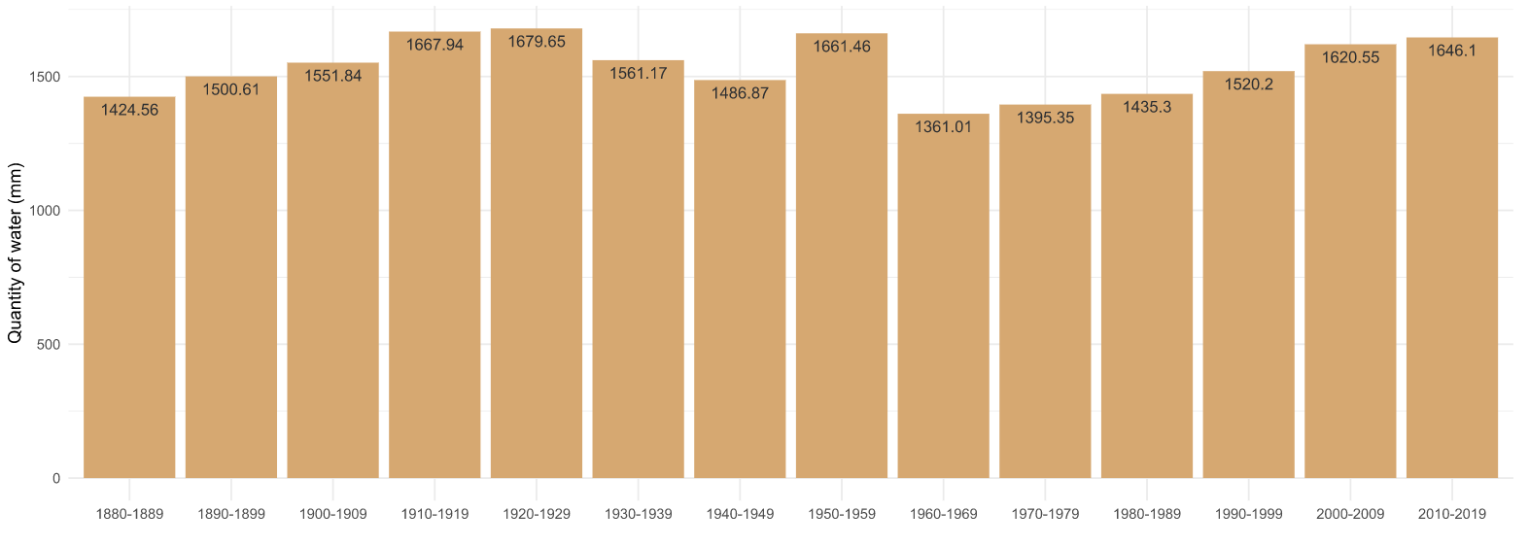
The boiling and drowning city
Histogram of rainfall per decade measured at the WMO weather station in Tokyo
Rainfalls of more than :
2 inches (50cm), increase of 30%
3 inches (76cm), increase of 70%

Slide 7
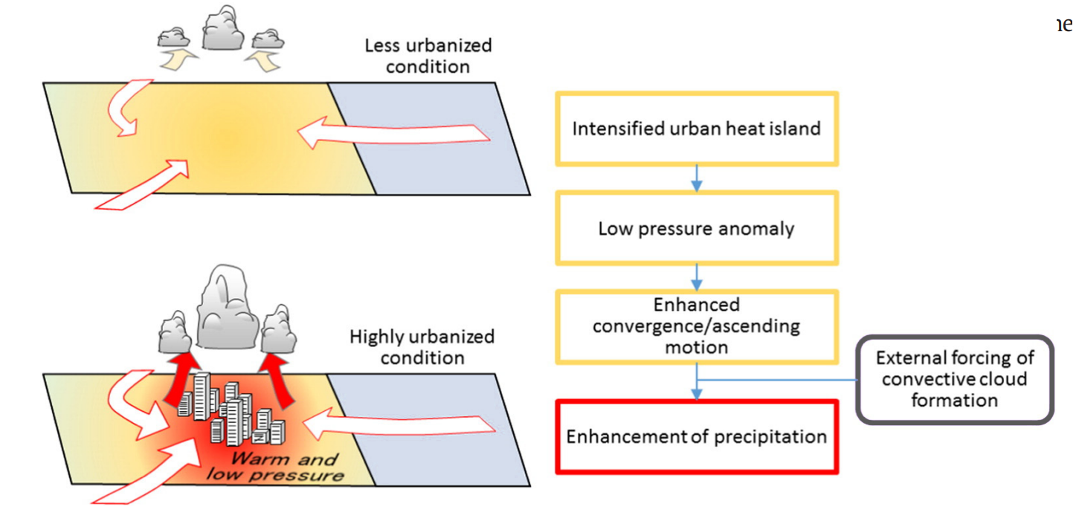
The boiling and drowning city
The path between urbanization and heavy rains
Schematic illustration of the impact of urban temperature rise on precipitation and relevant process (from N. Seino et al. / Urban Climate 23 (2018) 8–35)

Slide 8
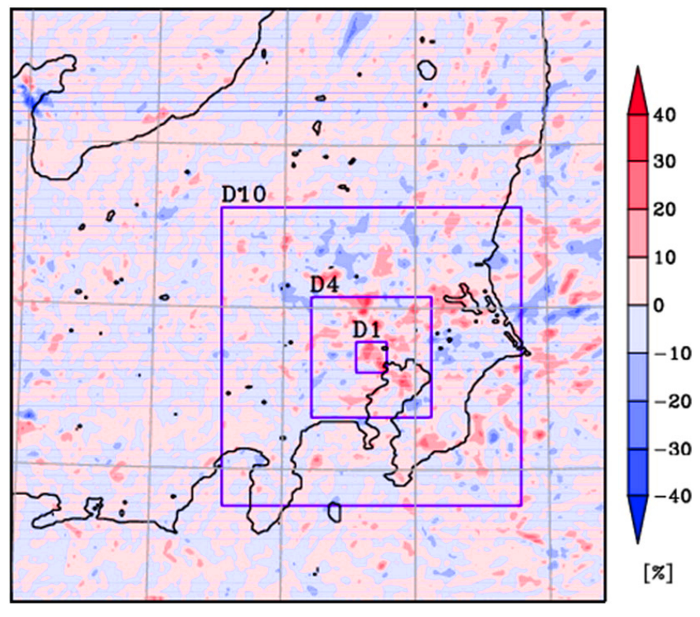
The boiling and drowning city
One take is all we need
Map displaying the simulated rainfall amount in the case of very dense urbanisation minus the simulated rainfall amount where urbanisation is low (results reduced to a percentage)

Slide 9
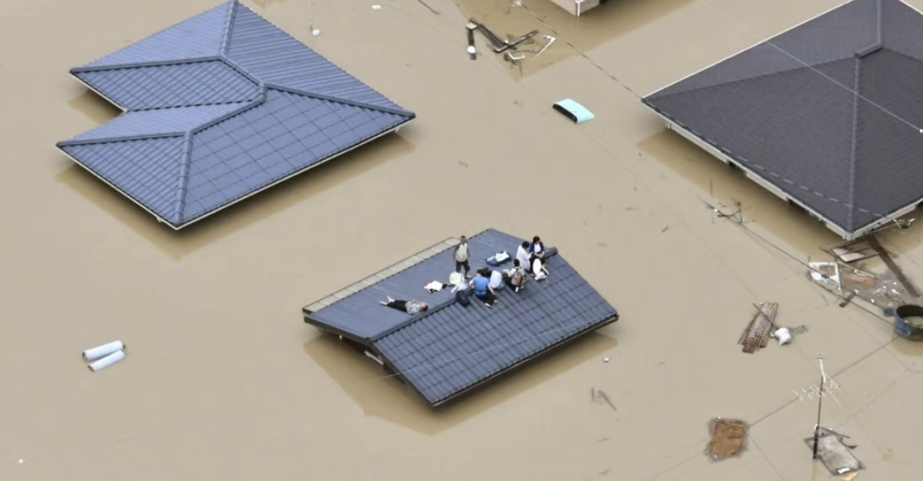
Water management in the biggest megacity
Photo taken from a Kyodo News helicopter on Saturday shows a residential area of Kurashiki

Slide 10
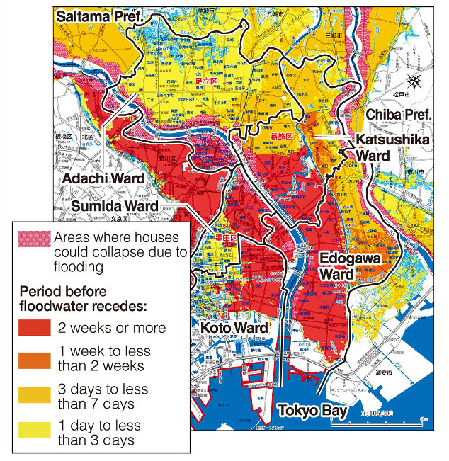
Water management in the biggest megacity
A hazard map released by five wards in eastern Tokyo (Prefecture of Tokyo)

Slide 11
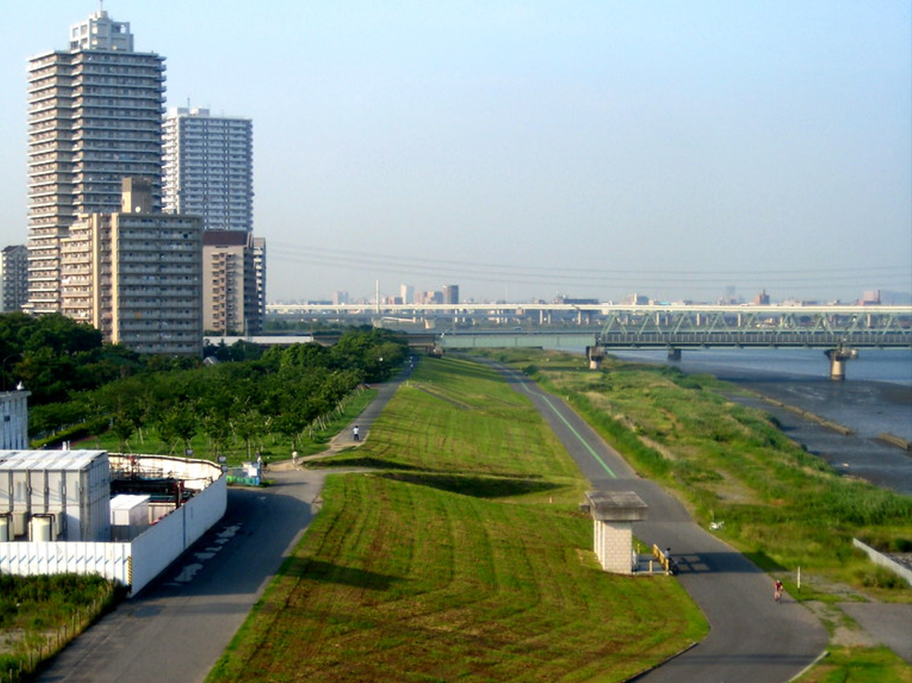
Water management in the biggest megacity
Super levee
Photo of a super-levee on the Edogawa in Tokyo (William Veerbeek)
High standard improved levee
Multifonctional design c

Slide 12
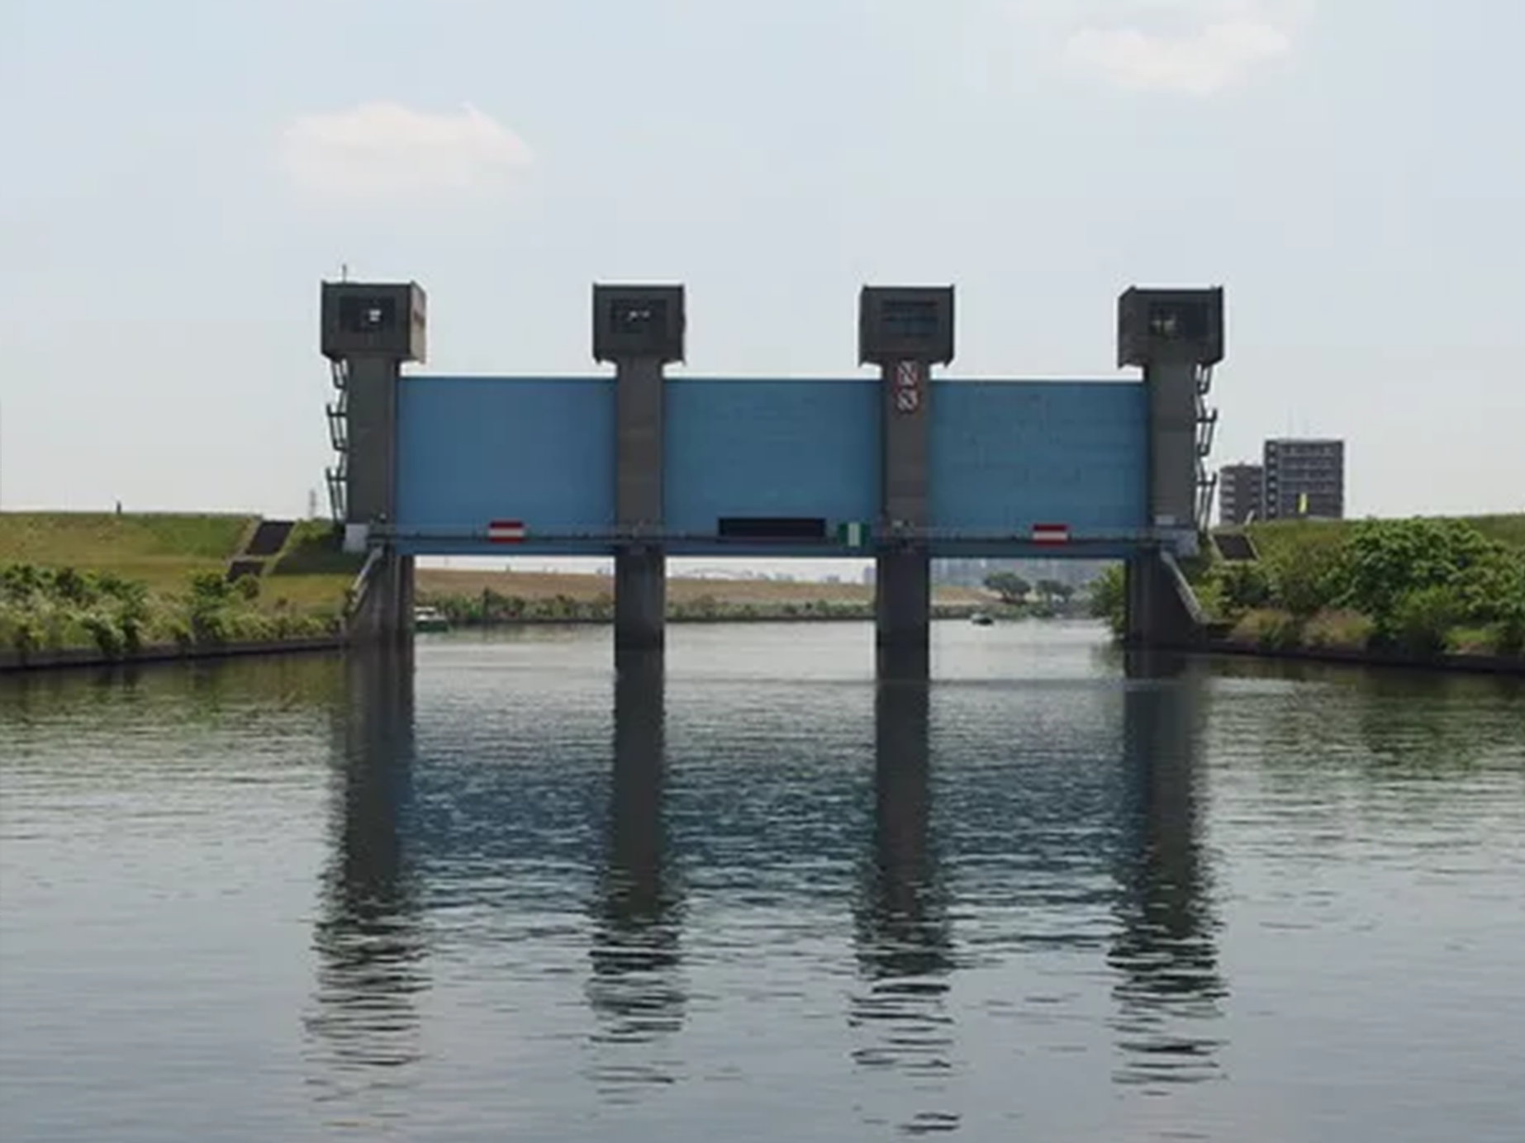
Water management in the biggest megacity
Gates
Various channels operating through large gates
Unpredictable flood events
protects the whole of eastern Tokyo
Photo of the Iwabuchi Sluice Gate

Slide 13
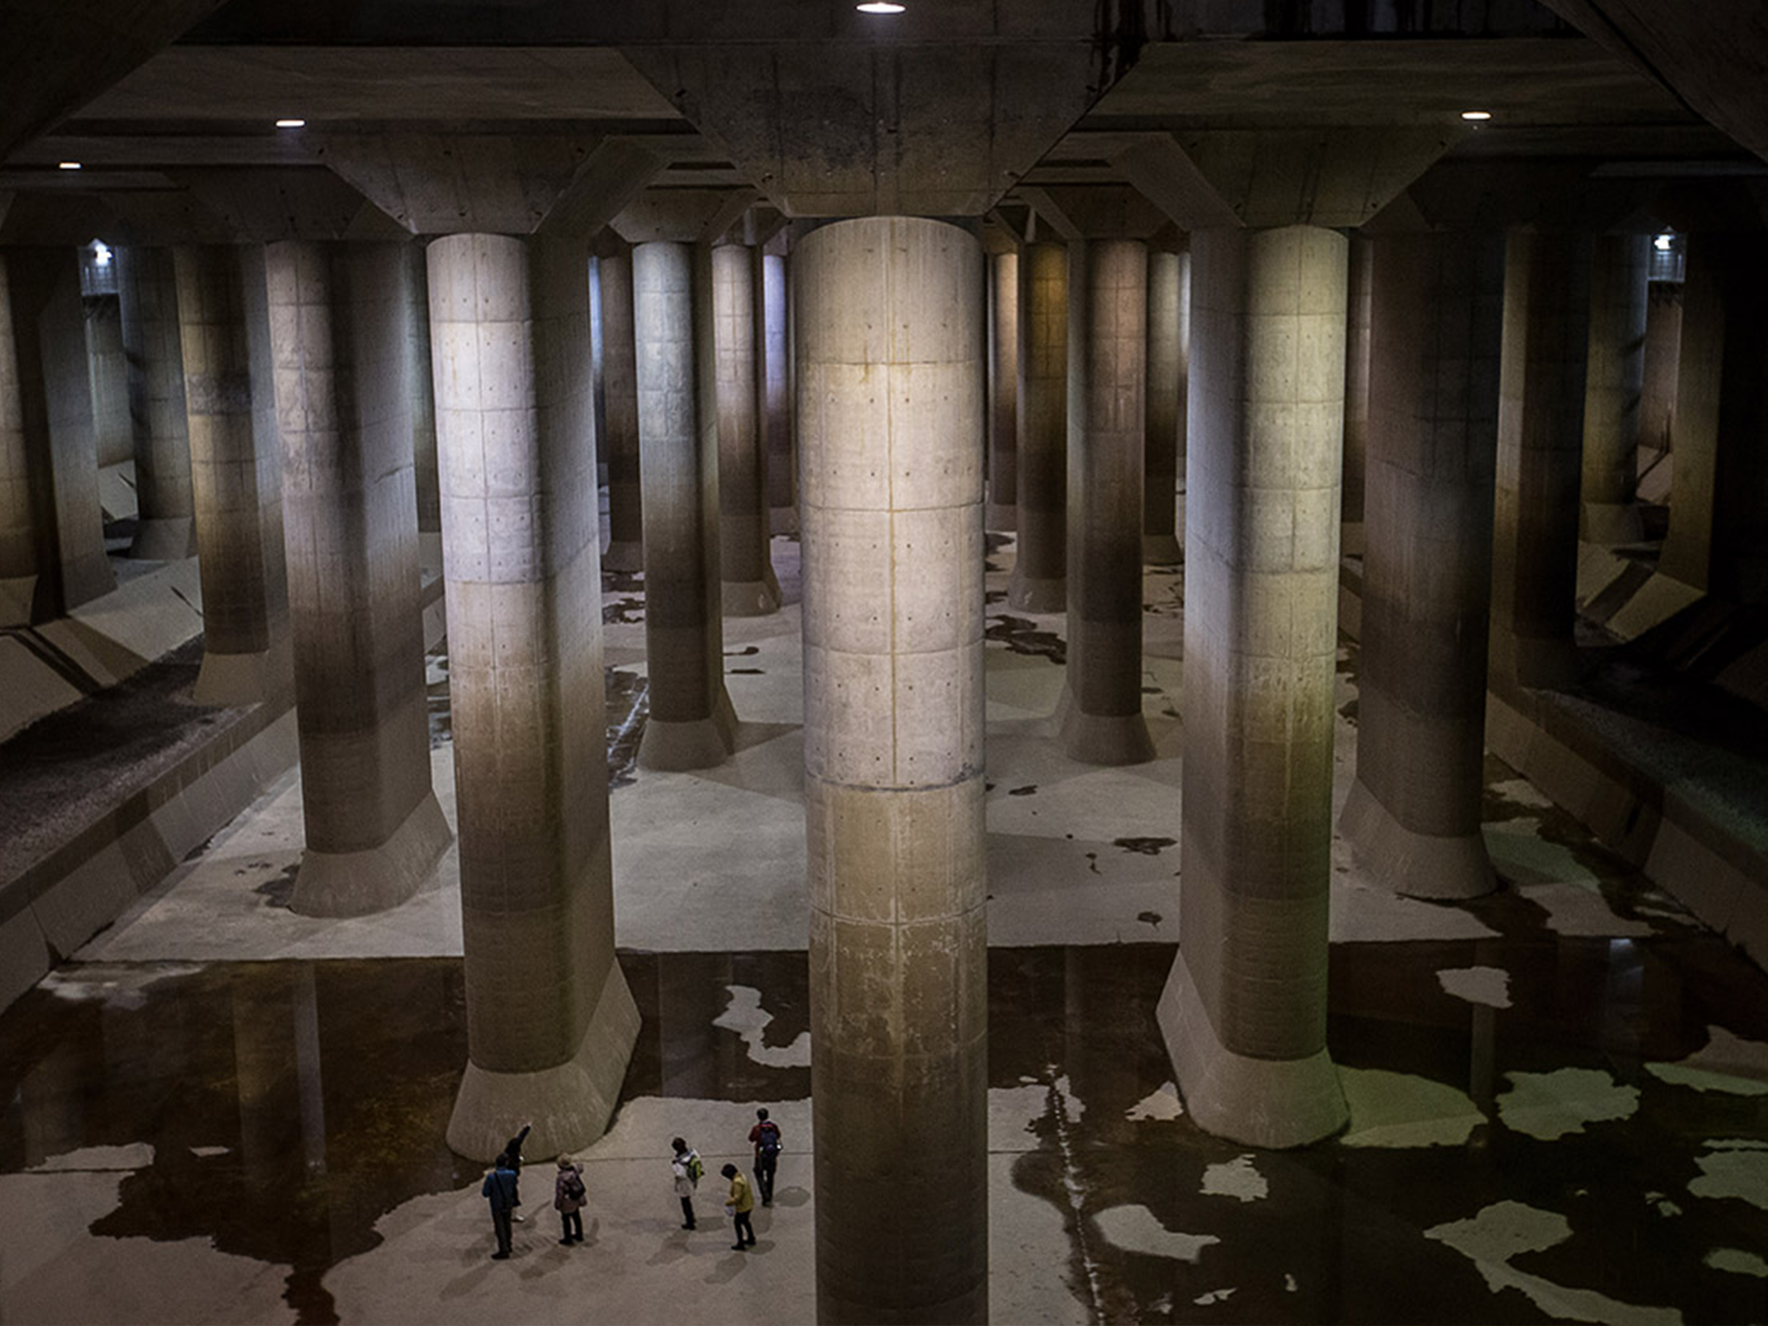
Water management in the biggest megacity
Tank
break the momentum of the rainwater
manage a one in a 200-year flood
saved $1.1 billion since it was commissioned in 2006
Photo of the Kasukabe surge tank

Slide 14
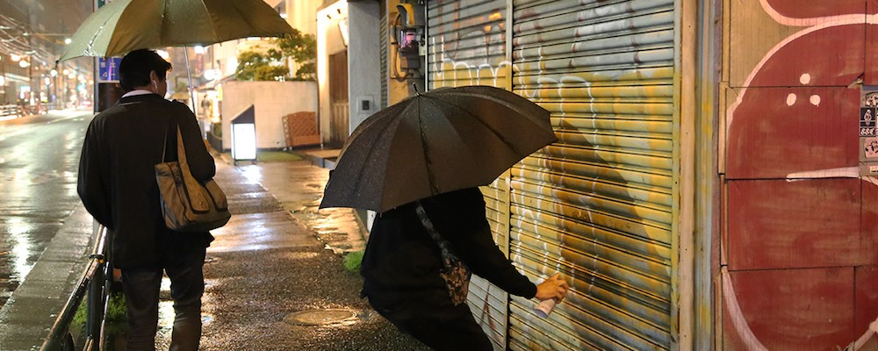
Conclusion
WANTO, Painting a fill-in

